Slide 1
EDA(Multivariate And Bivariate Analysis)Insights And Strategic Recommendations
Presented by Purushottam Mitra

Slide 2

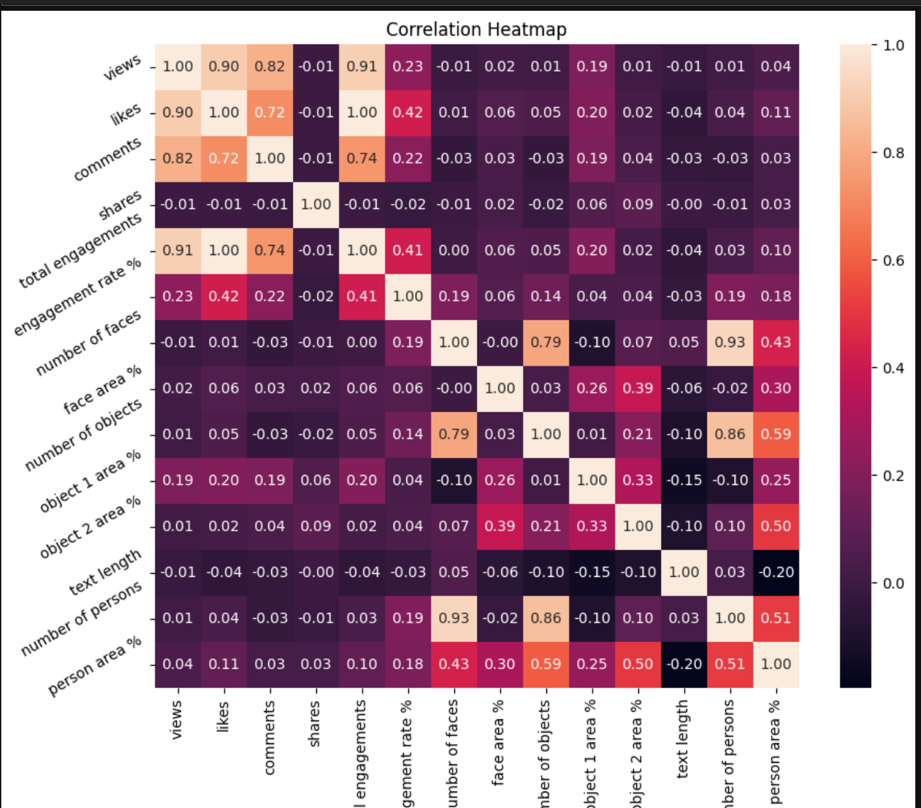
Correlation-Heatmap
Inferences Drawn From This Correlation Heatmap
M
a
k
e
views is positively correlated with Likes, comments, Total Engagements
Comments is positively correlated with Views, Total Engagements
Likes is positively correlated with Total Engagements, Comeents
Total Engagement is moderately correlated with Engagement Rate
First of all, I will extract the variables which are highly positively correlated.
y
o
u
r
s
a
l
e
s
p
i
t
c
h
2

Slide 3
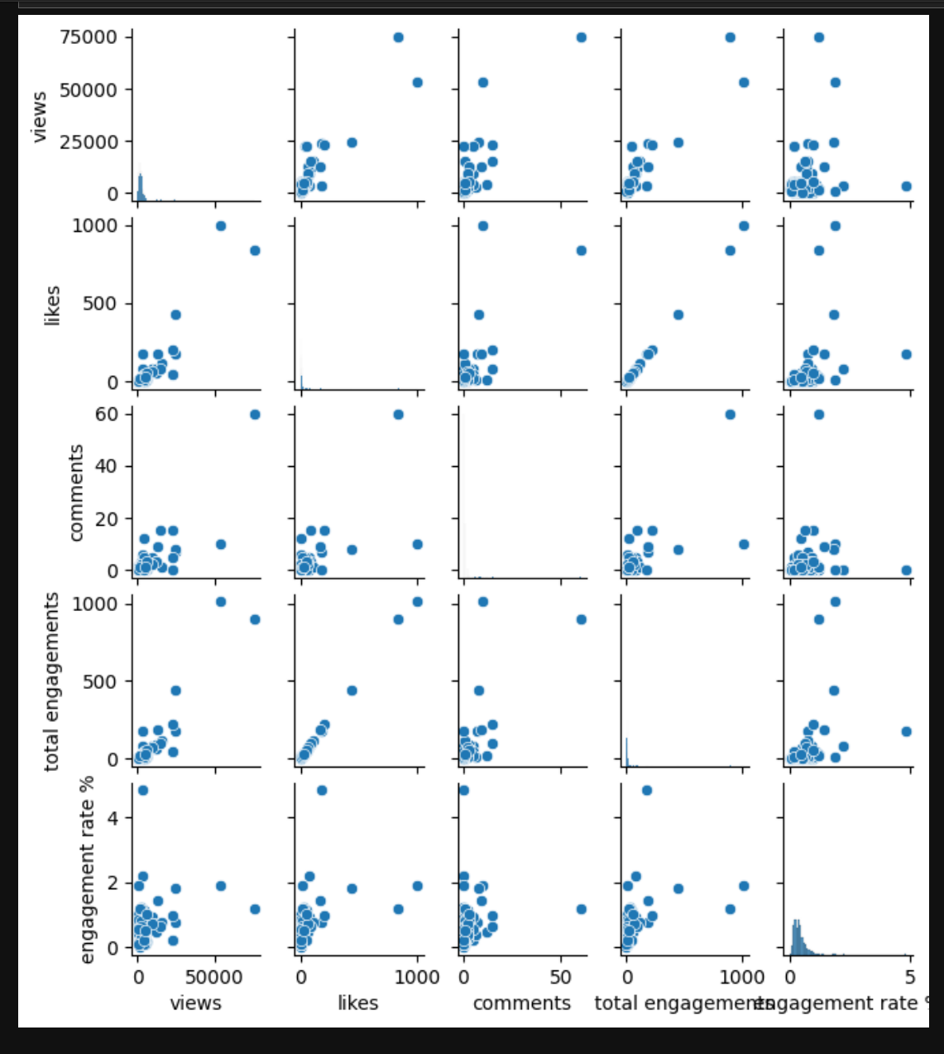

Pairplot
Detailed Insights
Total Engagements vs. Views:
Insight: There is a high positive correlation , it indicates that as the number of views increases, total engagements also increase significantly. This suggests that more visible posts naturally drive more interactions.
Recommendation: Focus on strategies to increase post visibility (e.g., using trending hashtags, posting at peak times).
Engagement Rate % vs. Total Engagements:
Insight: There is a positive correlation indicates that higher total engagements are associated with higher engagement rates. This means that posts that engage more people tend to have a higher proportion of engaged viewers.
Recommendation: Create highly engaging content (e.g., interactive posts, contests) to boost overall engagement and engagement rate.
Text Length vs. Engagement Rate %:
Insight: Based on the analysis, it appears that content text length (approximated by the number of comments) is weakly correlated with total engagements and engagement rate %. This suggests that simply increasing the length of content may not significantly boost engagement metrics. Therefore, focusing on writing concise and engaging content is recommended.
Recommendation: If the correlation is negative, focus on shorter, more impactful text. If positive, provide detailed and informative content.
Number of Faces and Engagement Metrics:
Insight: From Analysis it appears that the number of persons in the images has a weak correlation with total engagement.
Recommendation: This suggests that simply increasing the number of people in an image does not significantly boost engagement metrics such as likes, comments, and shares. Instead, other factors may be more influential in driving engagement.
Dominant Colour and Engagement Rate %:
Insight: Our analysis indicates that the dominant color of a post is highly correlated with both total engagements and the engagement rate. Posts with bright and eye-catching colors tend to attract more attention, leading to higher interaction rates.
Recommendation: Use colors that are associated with higher engagement rates more frequently in posts.
[
h
c
t
i
p
s
e
l
a
s
r
u
o
y
e
k
a
M
3

Slide 4
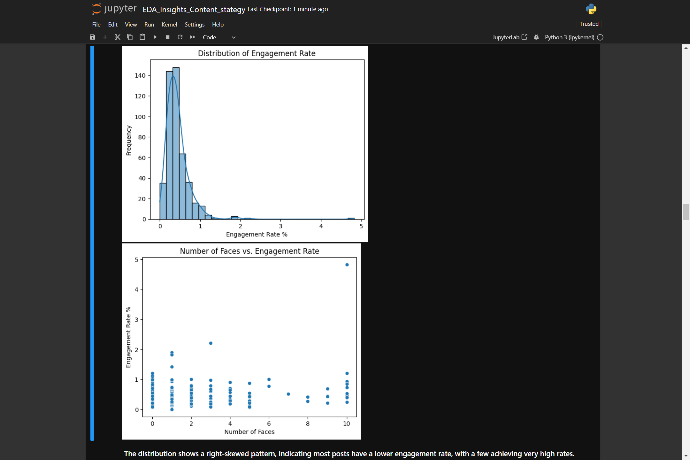

Distribution Of Engagement Rate% and its relation to number of Faces
h
c
t
i
p
s
e
l
a
s
r
u
o
The distribution shows a right-skewed pattern, indicating most posts have a lower engagement rate, with a few achieving very high rates.
There is no clear trend, suggesting the number of faces alone may not significantly impact engagement rate
y
e
k
a
M
4

Slide 5


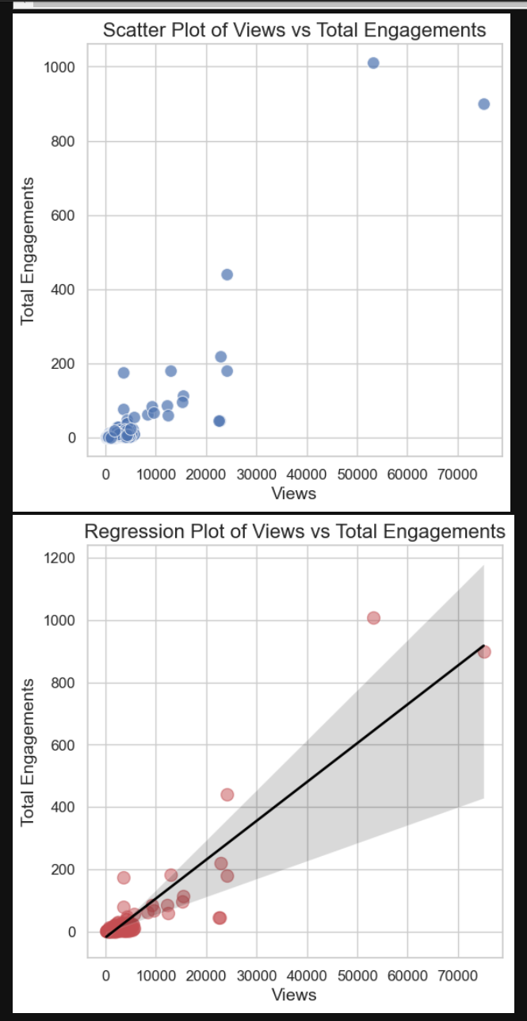
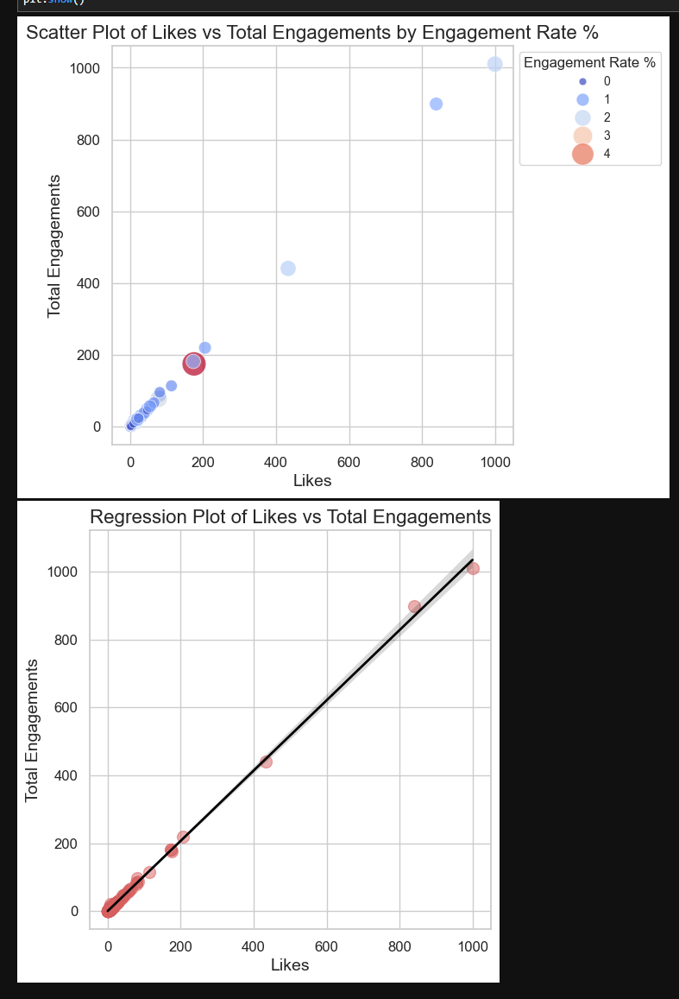
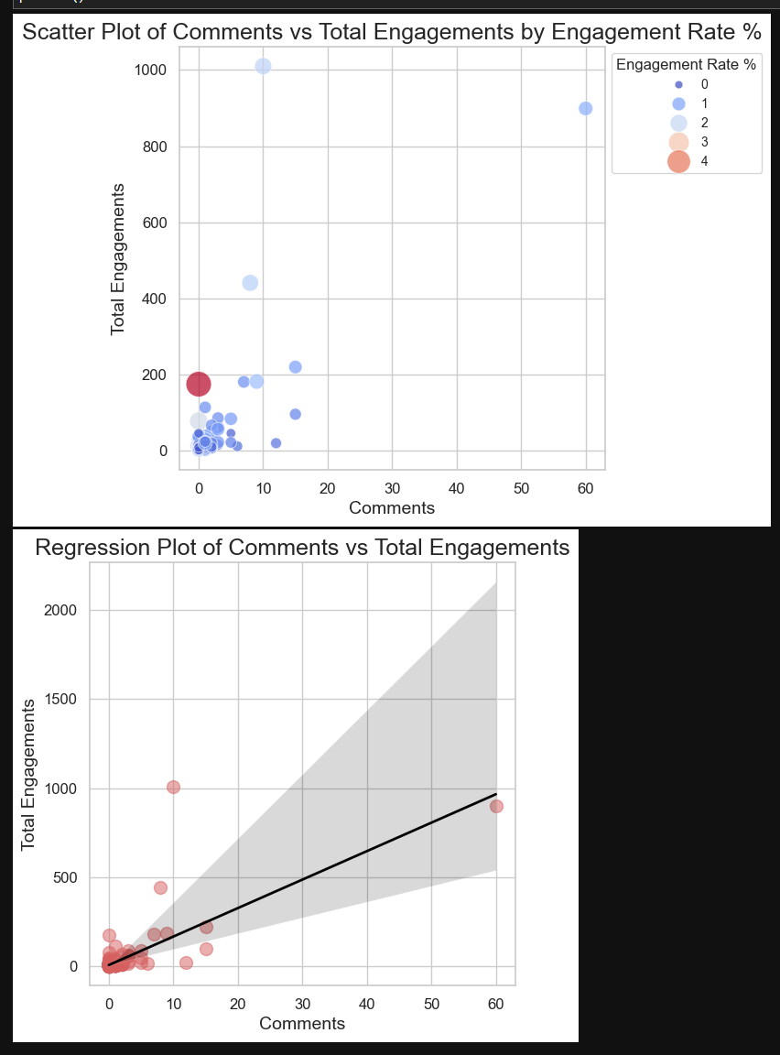
HOW IT WORKs
A Comparative study of Views, Likes And Comments with Respect To Engagement and Its Rate
M
a
k
e
y
o
u
r
s
Share a story on how your services works. Produce a quick demo video your audience can watch or share descriptive step-by-step photo.
a
l
e
s
p
i
t
c
h

Slide 6

Analysis Based on above analysis, it is observed that: Views, Likes, and Comments are directly proportional to or highly correlated with Total Engagements and Engagement Rate. Increasing the number of Views, Likes, and Comments on a post will likely lead to higher Total Engagements and a better Engagement Rate. Recommendations To increase the Views, Likes, and Comments of a post, consider the following strategies: Create High-Quality Content Visual Appeal: Use high-quality images and videos. Ensure your content is visually appealing and professionally presented. Relevance: Post content that is relevant to your audience’s interests and needs. Value: Provide value through informative, entertaining, or inspirational content. Optimize Posting Times Audience Insights: Use insights and analytics to determine when your audience is most active. Peak Times: Post during peak times when your audience is most likely to engage. Engage with Your Audience Respond to Comments: Engage with users by responding to their comments promptly. Ask Questions: Encourage interaction by asking questions or prompting users to share their opinions. Call to Action: Include clear calls to action (CTAs) encouraging likes, shares, and comments. Leverage Hashtags and Keywords Relevant Hashtags: Use relevant and trending hashtags to increase the reach of your posts. SEO: Optimize your captions and descriptions with keywords that your audience is searching for. Collaborate with Influencers Partnerships: Partner with influencers in your niche to reach a broader audience. User-Generated Content: Encourage users to create and share content related to your brand. Promote Posts Ads: Use paid promotions and social media ads to boost the visibility of your posts. Cross-Promotion: Promote your posts across different social media platforms. Analyze and Adapt Insights: Regularly analyze your posts' performance to understand what works best. Adapt Strategies: Adapt your strategies based on what is driving the most engagement.

Slide 7
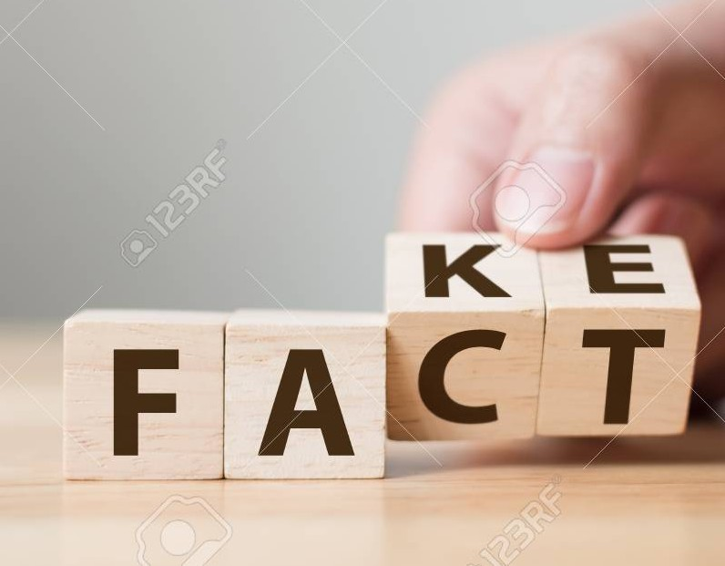
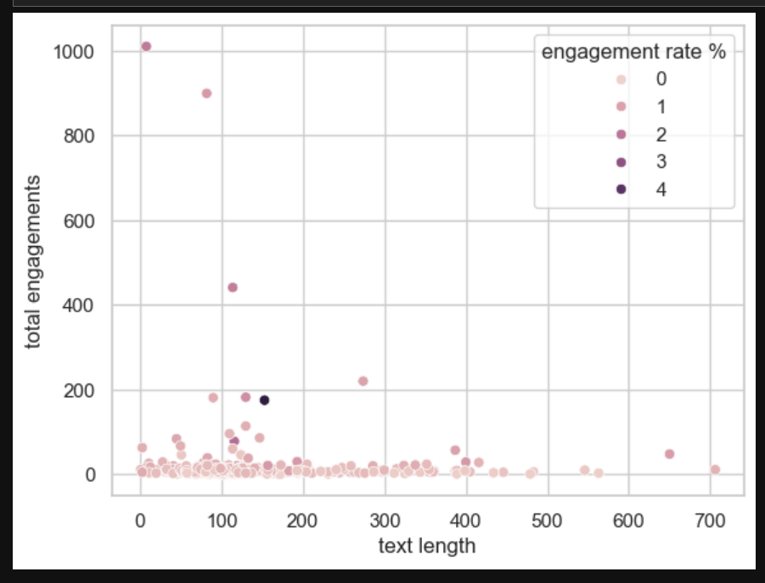
Post Content Length(Text Length) VS Total Engagement and its Rate
Analysis
Based on the analysis, it appears that content text length (approximated by the number of comments) is weakly correlated with total engagements and engagement rate %. This suggests that simply increasing the length of content may not significantly boost engagement metrics. Therefore, focusing on writing concise and engaging content is recommended.
Recommendations
Focus on Quality over Quantity: Instead of aiming for longer text, prioritize the quality and relevance of the content. Ensure that each piece of content adds value to the audience.
Engaging Headlines: Use compelling headlines and introductions to capture the audience's attention quickly.
Visual Elements: Incorporate images, videos, and infographics to make the content more engaging and visually appealing.
Interactive Content: Encourage interaction through questions, polls, and call-to-action phrases to boost engagement rates.
Regular Updates: Keep content fresh and updated to maintain audience interest and engagement over time

Slide 8
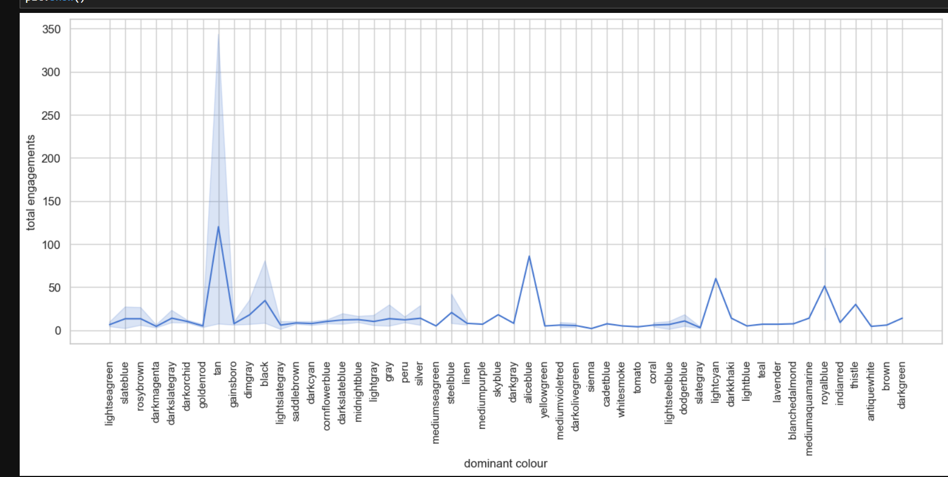

Dominant Colour VS Total Engagement and its Rate
Analysis
Our analysis indicates that the dominant color of a post is highly correlated with both total engagements and the engagement rate. Posts with bright and eye-catching colors tend to attract more attention, leading to higher interaction rates.
Recommendations:
Use Bright and Eye-Catching Colors:
Primary Colors: Utilize vibrant primary colors such as red, blue, and yellow. These colors are known to capture attention quickly.
High Contrast: Ensure high contrast between the background and the main elements of the post. This makes the content stand out.
Warm Colors: Warm colors like orange, red, and yellow are inviting and can elicit a sense of urgency, encouraging users to engage.
Consistent Color Theme:
Brand Consistency: Maintain a consistent color scheme that aligns with your brand identity. This helps in creating a cohesive visual experience for the audience.
Color Psychology: Understand the psychological impact of colors. For instance, blue often represents trust and calmness, while red can evoke excitement and urgency.
Design Elements:
Text and Icons: Ensure that text and icons are easily readable against the background color. Avoid using similar hues that can make the content hard to decipher.
Highlight Key Areas: Use contrasting colors to highlight call-to-action buttons or key information to draw immediate attention. Use of Visuals:
Bright Images: Incorporate images with bright and vibrant colors. These images can make your posts more appealing and engaging. Infographics and Illustrations: Use colorful infographics and illustrations to convey information more effectively and engagingly.

Slide 9
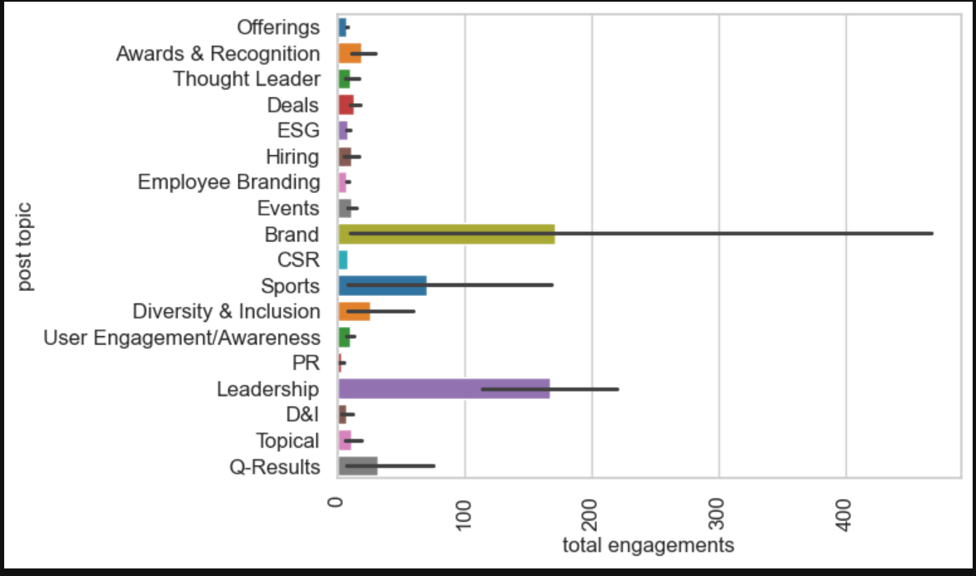
Post Topic VS Total Engagement and its Rate
Analysis
Based on the analysis of the dataset, it is observed that the post topic has a direct correlation with total engagement and the engagement rate. Specifically, posts that focus on topics related to "leadership" and "brand" tend to receive higher total engagements and better engagement rates. This suggests that audiences are more interested in and interact more with content revolving around these topics.
Recommendation
Focus on High-Engagement Topics: Create more content centered around "leadership" and "brand". These topics resonate well with the audience, leading to higher engagement. Examples of "leadership" content could include leadership tips, profiles of successful leaders, leadership challenges, and success stories. "Brand" content could include brand-building strategies, case studies of successful brands, brand stories, and tips for brand management.
Content Strategy: Develop a content calendar that ensures regular posting of topics related to leadership and brand. Mix these high-engagement topics with other content to maintain variety and cater to different audience segments.
Engagement Techniques: Use engaging formats such as videos, infographics, and interactive posts when discussing leadership and brand topics. Encourage audience participation through polls, Q&A sessions, and discussion prompts related to these topics.
Analyze and Adapt: Continuously monitor the performance of posts to see which specific aspects of leadership and brand topics get the most engagement. Use this data to refine and adapt your content strategy, focusing on subtopics that show the highest engagement rates.
SEO and Keywords: Optimize posts with relevant keywords related to leadership and brand. This can help in improving the organic reach of the posts. Examples of keywords could include "leadership skills", "brand strategy", "successful leaders", "brand growth", etc.
Collaborations and Influencers: Collaborate with influencers and thought leaders in the fields of leadership and brand management. This can help in leveraging their audience and increasing the reach and engagement of your posts.

Slide 10
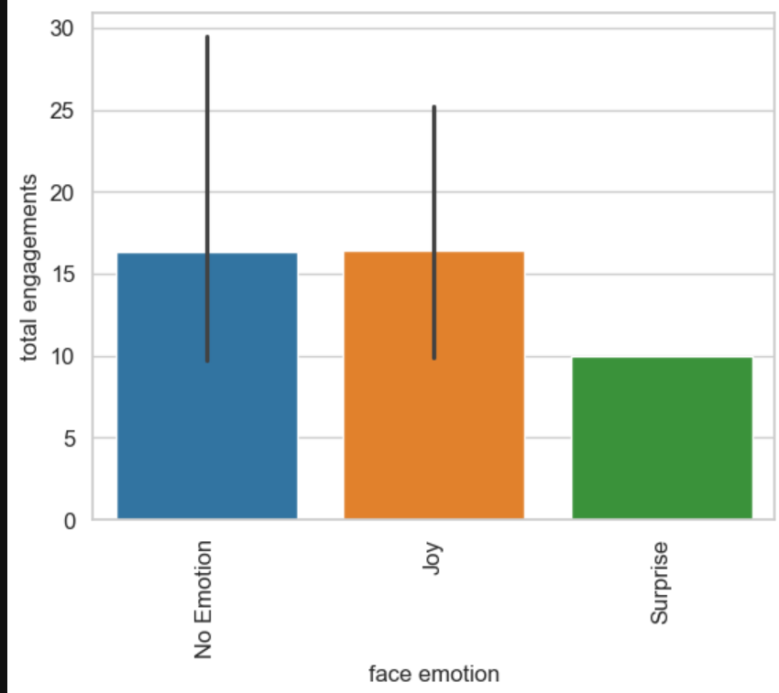
Face Emotions VS Total Engagement and its Rate
Analysis:
Moderate Correlation: The analysis shows that face emotion is moderately correlated with total engagement.
Joyous Faces: Joyous faces tend to attract more views and engagements compared to other emotions, such as surprise.
Recommendations:
Use Joyful Images: Focus on using images with joyful expressions to increase engagement.
A/B Testing: Conduct A/B testing with different face emotions to further refine the most effective types of facial expressions.
Regular Analysis: Analyze engagement patterns regularly to stay updated with audience preferences and trends.
Content Context: Ensure that the context and content of the images align with the overall message and branding strategy.
10

Slide 11
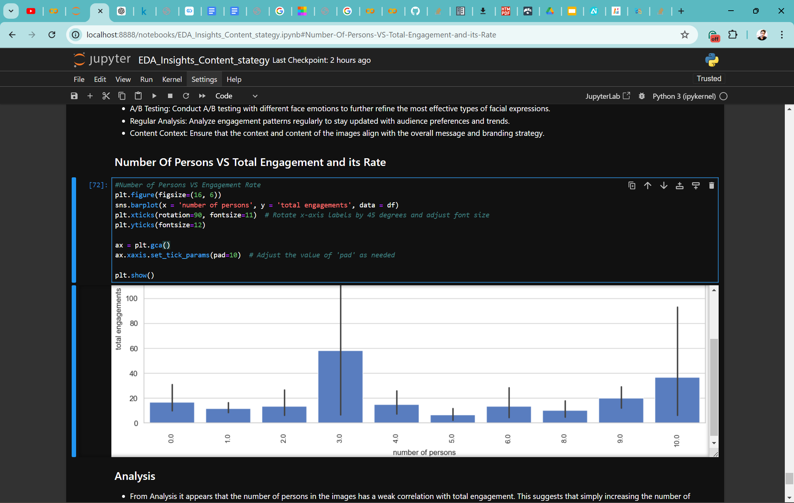
Number Of Persons VS Total Engagement and its Rate
Analysis
From Analysis it appears that the number of persons in the images has a weak correlation with total engagement. This suggests that simply increasing the number of people in an image does not significantly boost engagement metrics such as likes, comments, and shares. Instead, other factors may be more influential in driving engagement.
Recommendations
Focus on Image Subject: Instead of increasing the number of persons in an image, pay attention to the subject matter of the image. Ensure that the subject is relevant, interesting, and aligns with your audience’s interests.
Enhance Image Quality: High-quality, visually appealing images tend to attract more engagement. Invest in good photography or design to make your images stand out.
Use Compelling Captions: Captions can significantly influence engagement. Use compelling, thought-provoking, or humorous captions to engage your audience.
Optimize Timing: Post images at times when your audience is most active. Use insights from your social media analytics to determine the best times to post.
Leverage Hashtags: Use relevant and trending hashtags to increase the visibility of your posts. This can help attract a wider audience and boost engagement.
Encourage Interaction: Prompt your audience to interact with your posts by asking questions, running polls, or encouraging them to tag friends.
Consistent Branding: Maintain a consistent brand aesthetic across all your posts. This helps in building brand recognition and loyalty.
11

Slide 12
Market Optimizing Image Content for Social Media Campaigns: Improving Marketing Campaigns For Infosys Approach( Step-By- Step )
Objective: Enhance engagement and visibility through strategic use of visual content on social media.
Key Components of the Strategy:
Optimize for High Visibility (Views)
Utilize Trending Hashtags and Topics: Use popular hashtags and current trends to increase post visibility.
Post Timing: Share content during peak engagement times for the target audience based on historical data analysis.
Cross-Promotion: Collaborate with influencers and other brands to expand reach.
Encourage Interactions (Likes, Shares, Comments)
Engaging CTAs: Include compelling calls-to-action in posts to prompt likes, shares, and comments.
Interactive Content: Create polls, quizzes, and contests to encourage active participation.
User-Generated Content: Encourage followers to share Infosys-related content for incentives like features on the official page or small rewards.
Leverage Visual Elements
Human Faces in Images: Include faces to increase engagement, ensuring they are balanced and portray positive emotions.
Diversity and Inclusion: Showcase diverse groups to appeal to a broader audience and promote inclusivity.
Strategic Use of Colours: Utilize engaging colours while maintaining Infosys' brand colours to strengthen brand identity.
Content Length and Information
Concise Messaging: Use concise captions that provide value upfront to capture attention quickly.
Detailed Posts: For complex topics, use longer posts with clear structure (emojis, bullet points) for readability.
Incorporate Objects and Logos
Branding: Ensure the Infosys logo is visible but not overwhelming, enhancing brand recognition.
Relevant Objects: Include objects related to the post’s topic (e.g., tech gadgets for tech-related posts).
Content Variety and Innovation
Mix of Content Types: Use images, videos, infographics, and GIFs to keep content diverse and engaging.
Innovative Formats: Experiment with new formats like AR filters and interactive videos to captivate the audience.

Slide 13
Implementation Plan
Content Calendar:
Develop a detailed schedule based on optimal engagement times.
Plan diverse content types and topics to maintain audience interest.
Performance Monitoring and Adjustment:
Use analytics tools to monitor post performance regularly.
Conduct A/B testing to refine strategies based on data insights.
Audience Feedback:
Collect feedback through comments, messages, and surveys.
Use feedback to tailor content and improve audience engagement.
Training and Resources:
Provide training on social media trends and best practices.
Equip the team with tools for high-quality graphic and video content creation.
Conclusion
By focusing on visibility, interactions, visual appeal, color strategy, content relevance, and innovation, Infosys can strengthen its social media presence and increase engagement rates. This data-driven approach ensures each post is optimized for performance, fostering a deeper connection with the audience and enhancing overall brand visibility and engagement.

Slide 14
THANK YOU

